Slide 1

Natural Vegetation
OF
INDIA- Introduction

Slide 2
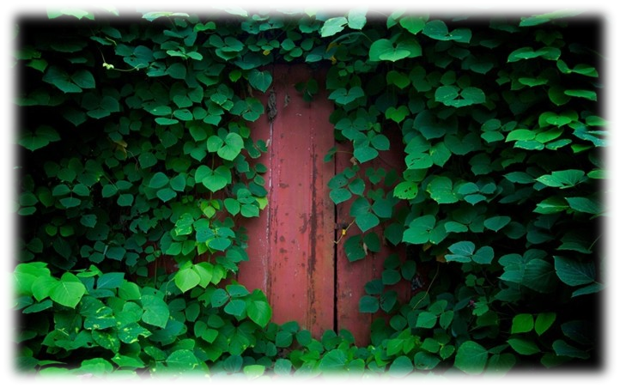
Introduction :
Natural vegetation (virgin vegetation) refers to a plant community which has grown naturally.
Natural vegetation is further classified into two:
Flaura.
Fauna

Slide 3

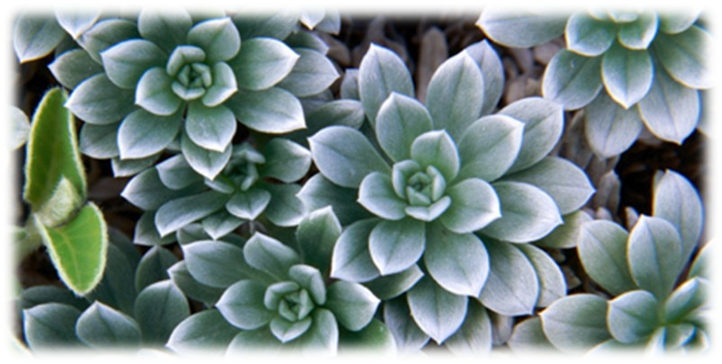
Flaura
Refers to the plants of a particular region.

Slide 4
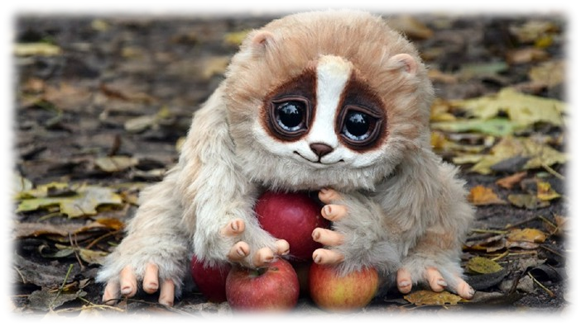
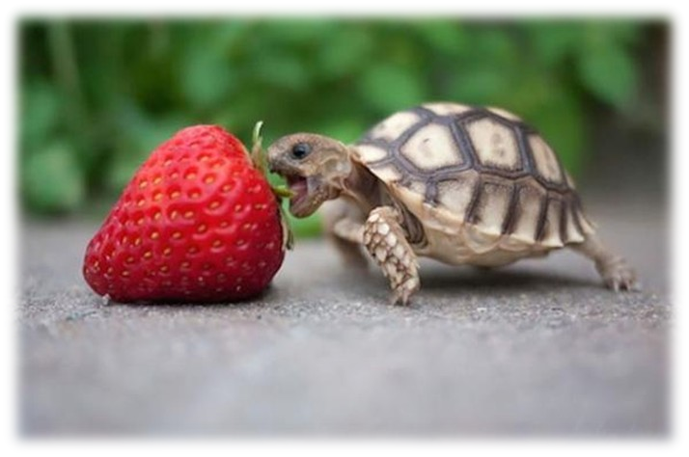
Fauna
Referred the animal species

Slide 5
Number Species Details
•
PLANT SPECIES: 47,000
•
(10TH IN THE WORLD AND 4TH IN ASIA).
•
FLOWERING PLANTS: 15,000.
•
ANIMAL SPECIES: 89,000.
•
BIRD SPECIES: 1,200 ( 13% OF THE WOLDS TOTAL BIRDS)
•
FISH SPECIES: 2,500 ( 12% OF THE WORLDS STOCK)

Slide 6
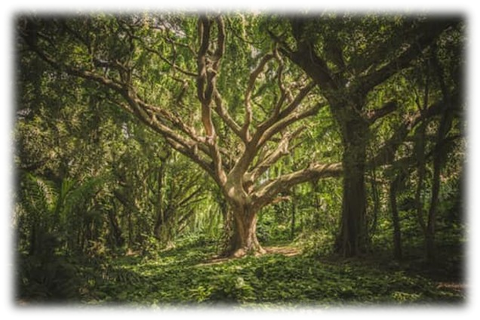
Forests
The forest is a complex eco -system consisting mainly high density of trees.
They function as habitats for organisms, hydrologic flow modulators, and soil conservers, constituting one of the most important aspects of the biosphere.

Slide 7
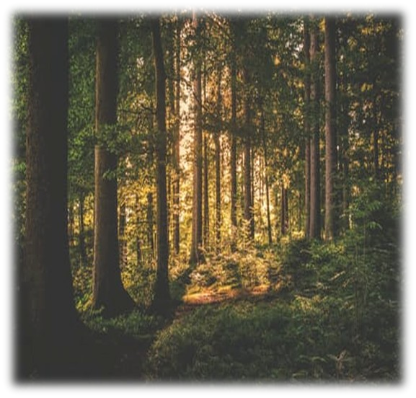
Importance Of Trees
Forest helps to enhance the quality of environment.
They modify the local climate.
They control soil erosion.
They regulate the flow of streams.
They control the wind force.
They maintain temperature.
They cause rainfall.
They provide humus to the soil.
They provide shelter to the wildlife.
They provide gum.
They provide wood for fire.
They provide medicines.

Slide 8
Types Of Vegetation
Tropical rainforest.
Tropical deciduous forest.
Tropical thorn forest and scrubs.
•
Montane forest( mountain forest).
Mangrove forest.

Slide 9
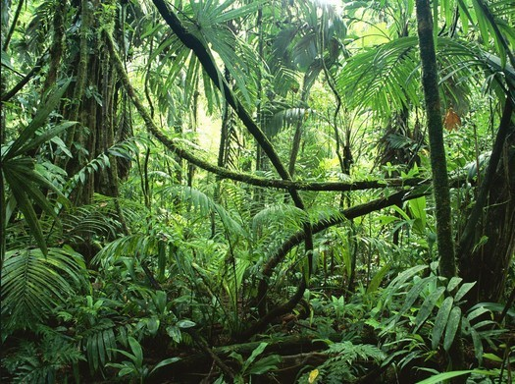
Tropical Rain forest
They are found in areas having more than 200 cm of rainfall.
This region is warm and wet throughout the year.
some example of trees are Mahogany, Rosewood, Rubber, Cinchona, etc.
•
Some examples of animals are Elephant, Monkey, Deer, Lemur, etc.

Slide 10
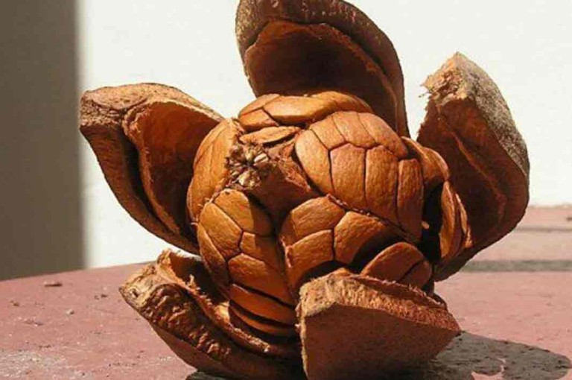
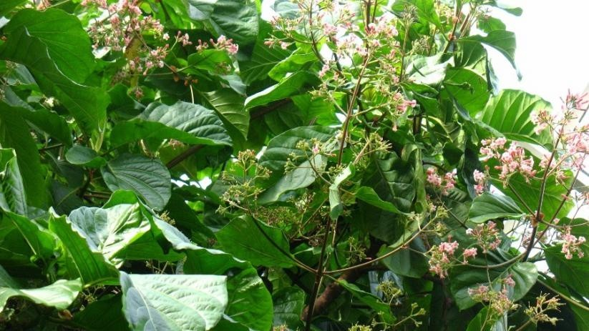
Plants
Mahogany
Cinchona

Slide 11
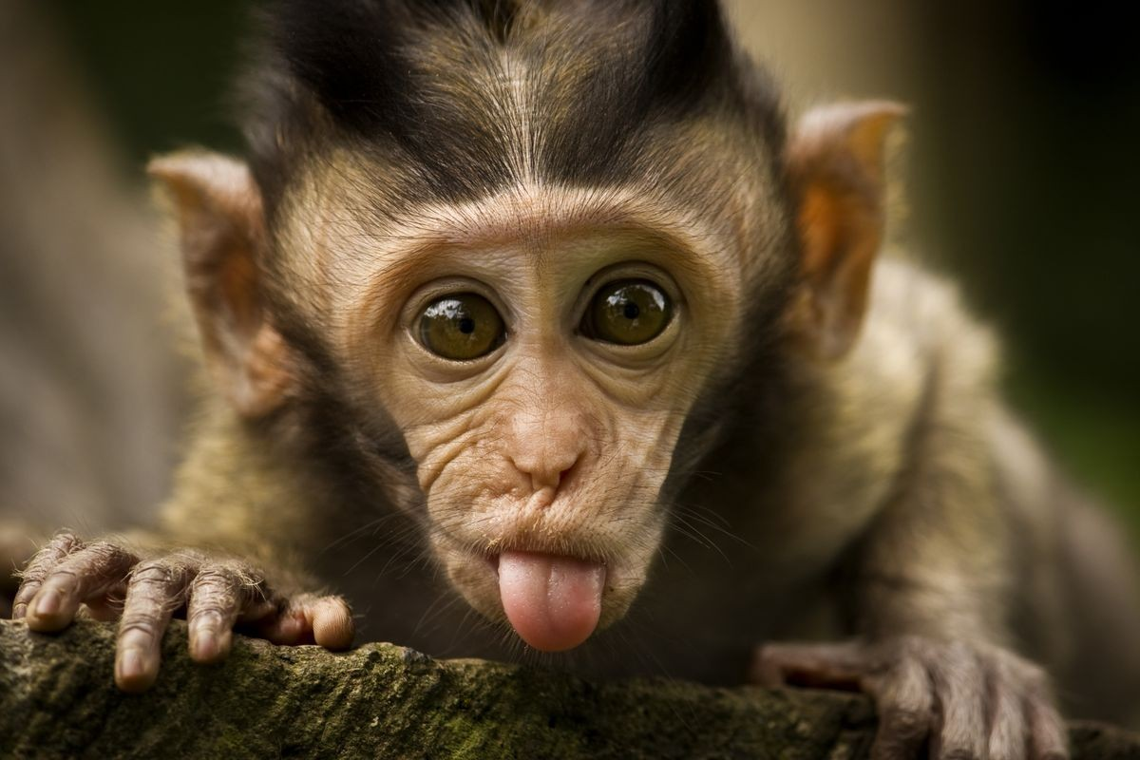
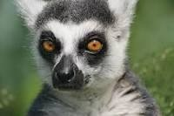
Lemur
Monkey

Slide 12
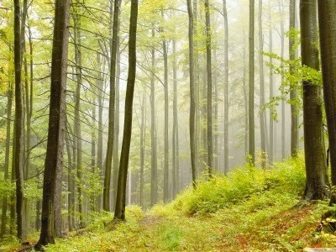
Tropical Deciduous Forest
They are found in areas having 70 cm to 200 cm of rainfal.
They are two types:
moist
dry
Some examples of trees are teak, sal, peepal, and neem.
Some examples of animals are lion, tiger, pig, deer, etc.

Slide 13
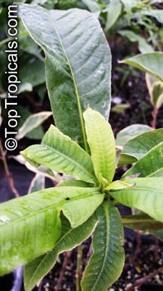
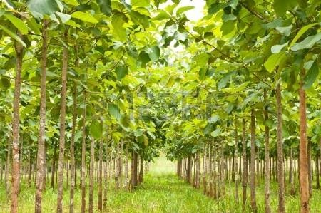
Plants
teak
sal

Slide 14
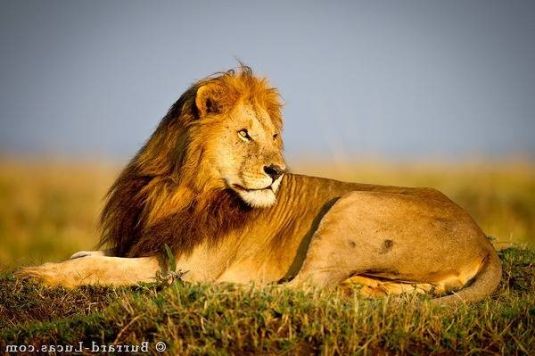
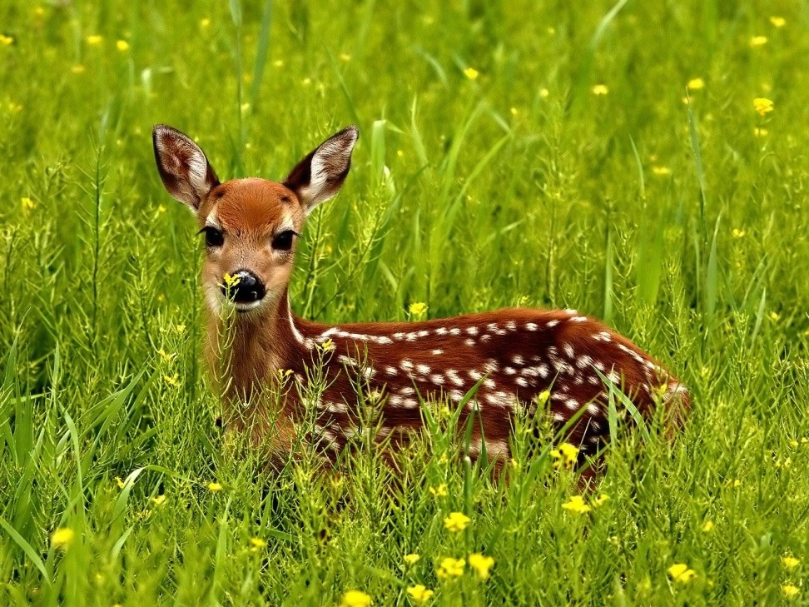
Animals
Lion
deer

Slide 15
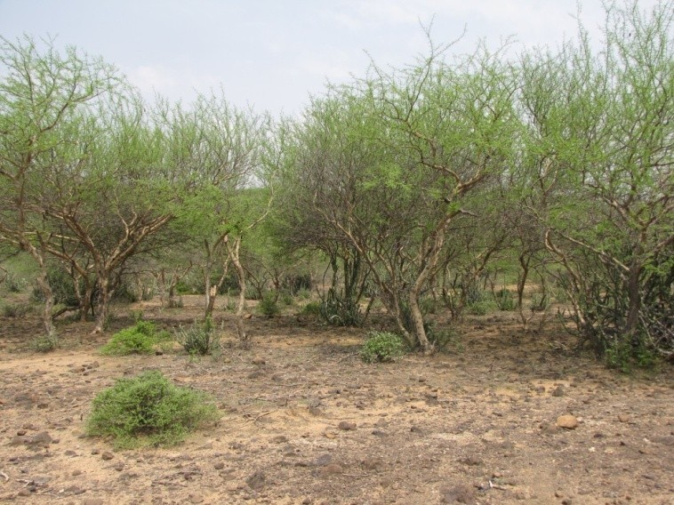
Tropical thorn forest and scrubs
They are found in areas having less than 70 cm of rainfall.
This region is dry most the time of the year.
Some examples of trees are cactus, palms etc
•
Some examples of animals are rats, lion, mice, and wild ass, etc

Slide 16
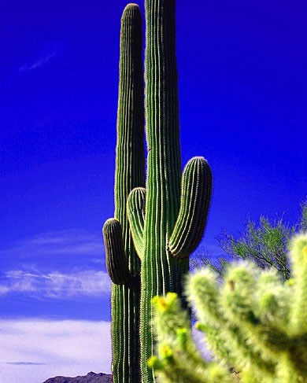
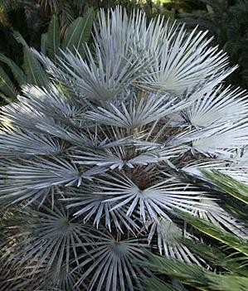
Plants
cactus
palms

Slide 17
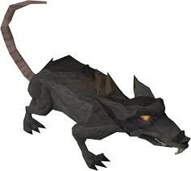
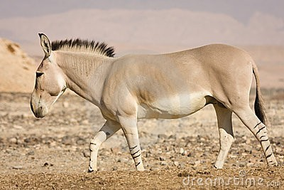
Animals
Rats
Wild ass

Slide 18
Montane forest
They are found mostly in Himalayas.
In this region, vegetation differ with altitude.
•
Some examples of trees are chestnuts, oaks etc.
Some examples of animals are rabbit, sheep, goats and red panda etc.

Slide 19
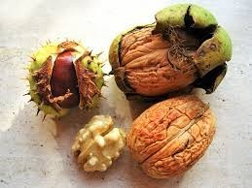
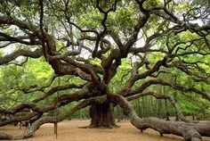
Trees
chestnut
oaks

Slide 20
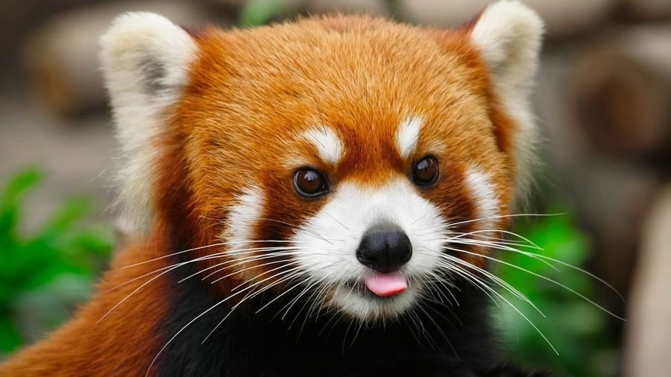
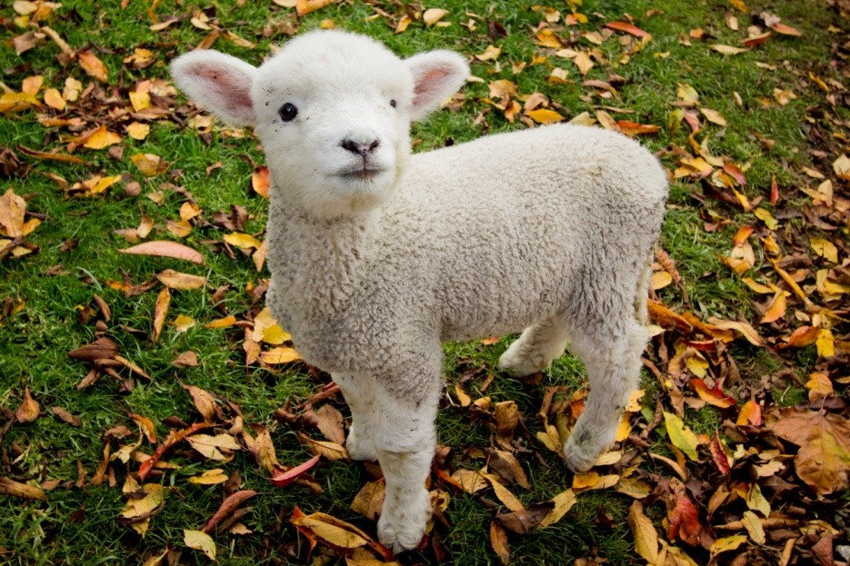
Animals
Red panda
Sheep

Slide 21
Mangrove forest
They are found in deltas i.e. Sunder bans, delta in west bengal.
The roots pf these plants are submerged in water.
Some examples of trees are coconut, palm, etc.
•
Some examples of animals are royal bengal tiger, crocodiles etc.

Slide 22
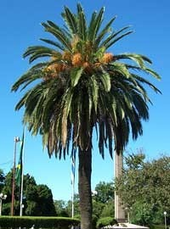

Plants
palm
coconut

Slide 23
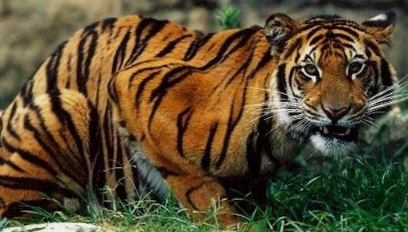
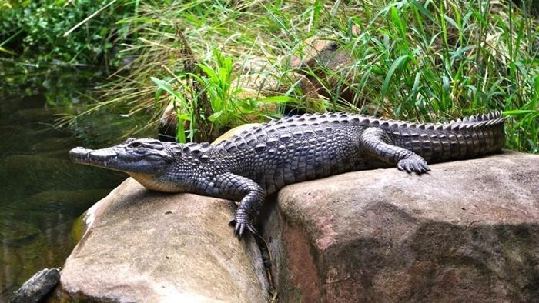
Animals
Royal bengal tiger • Crocodiles

Slide 24
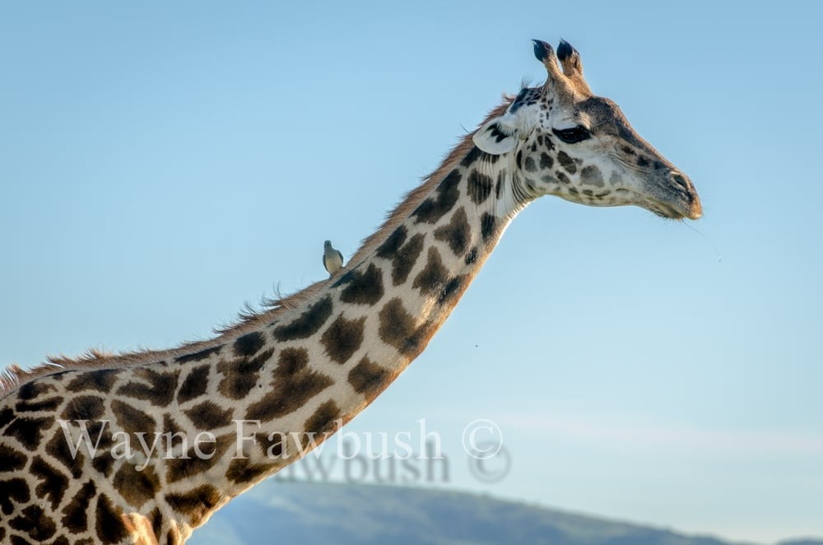
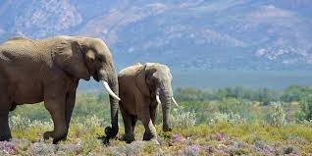
Wildlife
Wildlife is an integral part of our ecosystem .Wildlife can be found in all ecosystems. Deserts, forests, rain forests, plains, grasslands, and other areas including the most developed urban sites, all have distinct forms of wildlife. Preservation of rate wildlife is of very great importance now.

Slide 25
Importance of Wildlife
To maintain ecological 'balance of nature' and maintain food chain and nature cycles.
It has economic value. Many wild plants provide useful substances like timber, paper, gums etc. And they also have wide applications in Ayurveda and other branches of medicine. Wild animals products are tusk, ivory, leather, honey etc.

Slide 26
Thank You

